Slide 1


SAP S/4HANA Training
MASTER DATA GOVERNANCE (SAP MDG)
Neeraj Gupta
Session 30
SAP MDG – BCV Side Panel integration with WDA

Slide 2
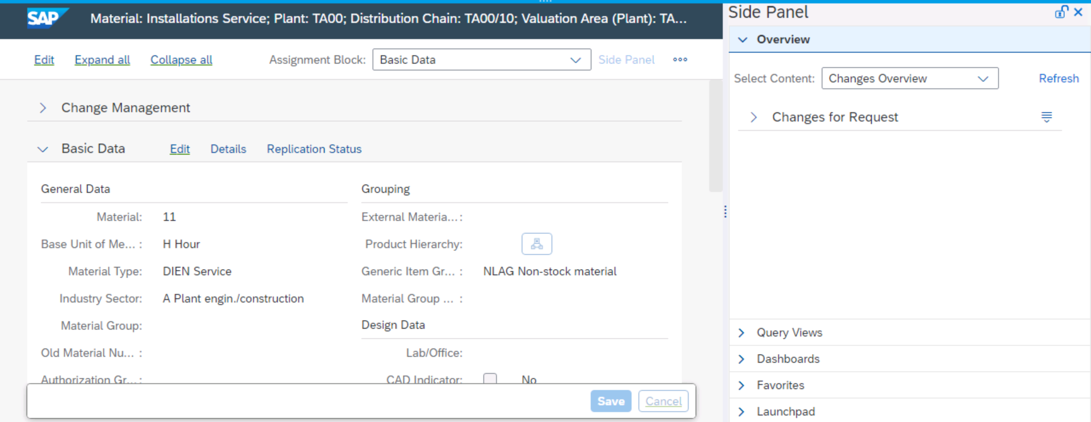
30
SAP MDG – Process Analytics
BCV as a side panel
Integration with Web Dynpro application - “hosting application”, as it hosts the side panel

Slide 3
30
SAP MDG – Process Analytics
Terms in Business Context Viewer (BCV):
BCV is the tool for Analytics in PLM 7.01 embedded into the PLM UI as side panel. Product Centric View (PCV in EHP4) is renamed as Business Context Viewer (BCV)
Search connectors
BCV queries
Query views
Overview
Dashboard
Data provider, for example, an InfoCube or InfoSet
Definition of the template in Enterprise Search
BAPI Adapter - BAPIs, RFC, or local call to the application
BCV uses NetWeaver Web Dynpro ABAP Page Builder technology for the dashboard, overview, and side panel creation
NetWeaver builds up BCV dashboards and overviews using Web Dynpro configurations

Slide 4
30
SAP MDG – Process Analytics
Integrate BCV in Applications
Preconditions for side panel integration
Install the Business Suite Foundation Layer (SAP_BS_FND) & add the interface BS_BUSINESS_CONTEXT_VIEWER to use access declaration of structure package
BCV business function /BCV/MAIN is active
Basic BCV configuration settings, such as a CONTEXT KEYS and MEANINGS
Role SAP_BCV_ADMIN as a template
UI of your application must be implemented in Web Dynpro ABAP
To integrate the BCV side panel to your application, a VIEW in required.
Steps in Implementation
Configure the usage of the BCV side panel
Initialize the side panel - NetWeaver API and action to open the side panel (IF_WD_SIDE_PANEL_API)
Update the side panel with parameter values from your application (tagging)

Slide 5
30
SAP MDG – Process Analytics
Integrate BCV in Applications
Steps in Implementation
View:
>> Page header named PAGE_HEADER (Target required to create the Side Panel link )
>> Empty view possible when using standard views (POWL) – Not recommended
>> Add the attribute MO_API (type reference to IF_WD_SIDE_PANEL_API) to the attributes of the view

Slide 6
30
SAP MDG – Process Analytics
Integrate BCV in Applications
Steps in Implementation
View:
>> Method WDDOINIT of the view – Code is implemented
*--------------------------------------------------------------------*
* This coding checks if BCV is active and if the user has the
* authority to execute the side panel. If the user is allowed to do
* this, the side panel is initialized.
*--------------------------------------------------------------------*
CONSTANTS:
* The context key „/PLMU/MATERIAL‟ is just an example, please adapt
* it to your needs
lc_context_key TYPE /bcv/fnd_context_key VALUE '/PLMU/MATERIAL'.
DATA:
lv_authorized TYPE boole_d,
lo_view TYPE REF TO if_wd_view.

Slide 7
30
SAP MDG – Process Analytics
Integrate BCV in Applications
Steps in Implementation
View:
>> Parameters
1. SIDE_PANEL_CONFIG_ID - '/BCV/SIDEPANEL’ or /BCV/SIDEPANEL_20’
OPEN_ACTION_NAME - 'OPEN_SP’ (action is triggered using the Web Dynpro ABAP Page Builder to open the side panel when the user chooses the Side Panel link)
* Open Side Panel
wd_this->mo_api->open( ).

Slide 8
30
SAP MDG – Process Analytics
Integrate BCV in Applications
Steps in Implementation
View:
>> Parameters
S_OPEN - Automatic / Manual
4. WIDTH - Optimized for screen resolution 1280x1024 (defaulted from BCV Configuration)
Enhance view:
Add a “transparent container” (title content) to the page header with the ID PAGE_HEADER_LINKS
Add a “link to action” to the transparent container with the ID OPEN_SP

Slide 9
30
SAP MDG – Process Analytics
Integrate BCV in Applications
Steps in Implementation
View:
>> Parameters

Slide 10
30
SAP MDG – Process Analytics
Integrate BCV in Applications
Steps in Implementation
Side Panel Update (Tagging)
Context key - ID defined in BCV Customizing to identify the application should be tagged using code
>> NetWeaver tagging service >> Class CL_WD_TAGGING_MANAGER

Slide 11
30
SAP MDG – Process Analytics
Integrate BCV in Applications
Steps in Implementation
Side Panel Update (Tagging)
Actual values of the context attributes needs be transferred to the side panel using the coding >> Implemented in the WDDOINIT method
*--------------------------------------------------------------------* * This coding is using the tagging service to do the tagging via * coding. The tags are bounded to the attributes of the view context. *--------------------------------------------------------------------*
DATA:
lo_tagging_service TYPE REF TO if_wd_tagging_service.
* Get instance of tagging service
lo_tagging_service = cl_wd_tagging_manager=>get_service_by_comp

Slide 12
30
SAP MDG – Process Analytics
Integrate BCV in Applications
Steps in Implementation
DATA TRANSFER
Hosting application (using the context key) and the currently displayed object
Use NetWeaver tagging service
Context attributes with tags are transferred to the side panel

Slide 13
30
SAP MDG – Process Analytics
Integrate BCV in Applications
Steps in Implementation
TAGGING SERVICE
TAGS: Tags are used as application-independent virtual field names like HTML tags
MEANINGS in BCV: Meanings are independent from the technical field names used by the different data providers, for example, BI or ES. Meanings are assigned to the fields of BCV queries >> Used to receive data from different data providers
Example:
It is assumed that two fields with the tag 1MATERIAL contain material IDs. If the values are equal, they are identifying the same object
Mandatory tag is the CONTEXT_KEY

Slide 14
30
SAP MDG – Process Analytics
Integrate BCV in Applications
Steps in Implementation
TAGGING SERVICE
TAGS: Tags are used as application-independent virtual field names like HTML tags
MEANINGS in BCV: Meanings are independent from the technical field names used by the different data providers, for example, BI or ES. Meanings are assigned to the fields of BCV queries >> Used to receive data from different data providers

Slide 15
30
SAP MDG – Process Analytics
Integrate BCV in Applications
Steps in Implementation
Tagging using Configuration
Configuration can enhance or overwrite the tagging assignment done in the code
Steps:
Call application and open the Web Dynpro screen that contains the Side Panel link
Add “&sap-config-mode=x” to the URL in the browser and enter
Right mouse click on the field that should be tagged and choose Tags >> Manage Tags
4. In the dialog box that appears, you can add your own tags or remove existing ones. Several tags to the same field or attribute can be assigned

Slide 16
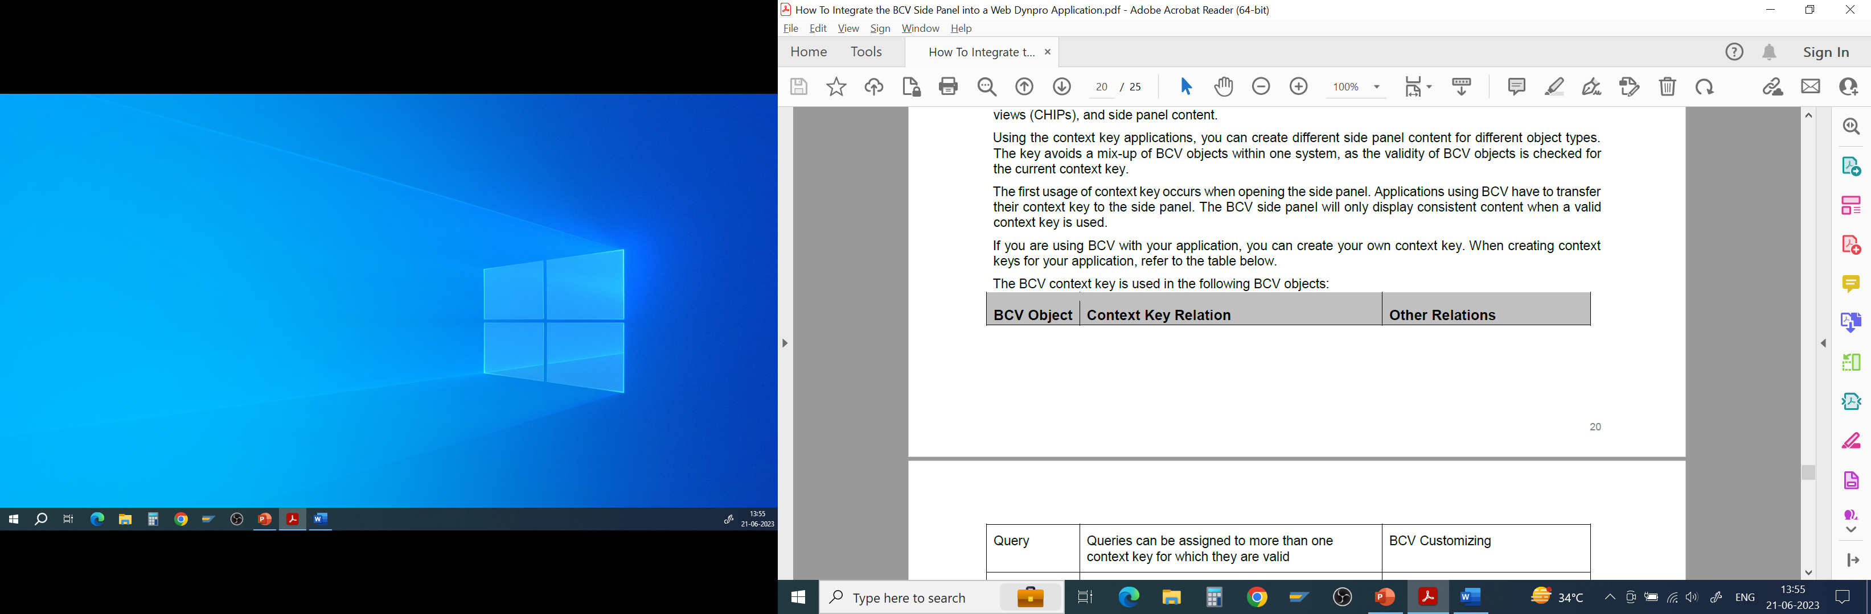
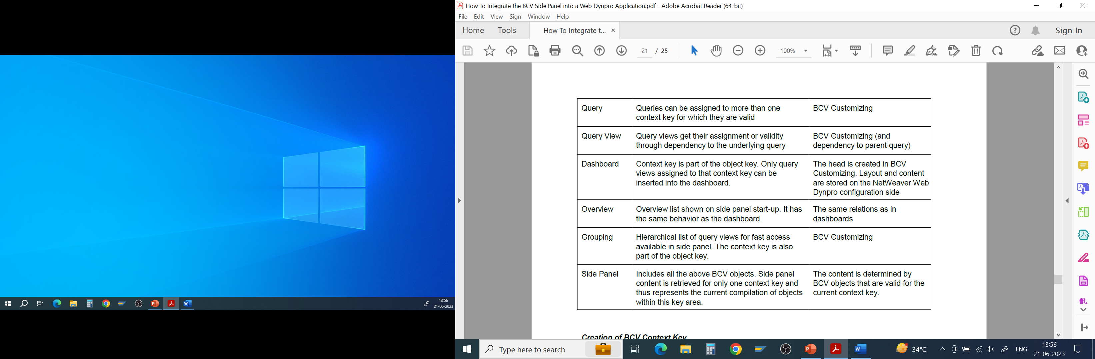
30
SAP MDG – Process Analytics
Context Key: BCV context key is the identifier of the hosting application. Validity of BCV objects is checked for the current context key. For custom applications, new context key can be created

Slide 17
30
SAP MDG – Process Analytics
Create BCV Context Key: SM30 >> (/BCV/V_CLF)
Use namespaces in development component. Application namespace should be part of the context key.
Connection between the BCV objects dashboard and overview and the NetWeaver pages is realized in the database table attribute CONFIG_ID of both BCV database tables

Slide 18
30
SAP MDG – Process Analytics
Integrate BCV in Applications
Steps in Implementation
Use case: FPM Based application >> FPM Application Configuration >>
Application parameter - Configuration ID of Side Panel
Enable the BCV side panel
>> Value - /BCV/SIDEPANEL or
/BCV/SIDEPANEL_20

Slide 19
30
SAP MDG – Process Analytics
Integrate BCV in Applications
Steps in Implementation
Use case: FPM application based on PLM UI Framework
Steps:
Application configuration
Side panel initialization (or authority check)
Side panel update (tagging)
>> Implement the BAdI /PLMU/EX_FRW_SIDEPANEL >> Coding for initialization
METHOD /plmu/if_ex_frw_sidepanel~check_authority.
*--------------------------------------------------------------------* * This method checks if the user has the authority to execute the
* BCV side panel.
* <-> CV_FAILED is ABAP_FALSE if the user has the authority, otherwise
* it is ABAP_TRUE. -------------------------------------------------------------------*

Slide 20
30
SAP MDG – Process Analytics
Integrate BCV in Applications
Steps in Implementation
Use case: FPM application based on PLM UI Framework
Side Panel Update (Tagging)
Implement BADI PLMU/EX_FRW_SIDEPANEL >> Application coding
METHOD /plmu/if_ex_frw_sidepanel~get_param_tag_map.
*--------------------------------------------------------------------* * This method does the tagging of the BCV side panel. This means that
* the context key and meanings are transferred from the hosting * application to the side panel to start it with appropriate values. * Pay attention to the naming conventions of the BCV tags, they are
* beginning with '/BCV/:'.
*--------------------------------------------------------------------*

Slide 21
30
SAP MDG – Process Analytics
Integrate BCV in Applications
Steps in Implementation
Use case: FPM Overview Page Application using Generic User Interface Building Blocks
Steps:
Application configuration
• Side panel initialization
• Side panel update (tagging)
Side Panel Initialization
>> Set the side panel link in the context navigation region (CNR) of the OVP floor plan
>> Application controller or in a feeder class
*--------------------------------------------------------------------*
* The following coding checks if the user has the authority to
* execute the BCV side panel.
*--------------------------------------------------------------------*

Slide 22
30
SAP MDG – Process Analytics
Integrate BCV in Applications
Steps in Implementation
Use case: FPM Overview Page Application using Generic User Interface Building Blocks
Steps:
Application configuration
• Side panel initialization
• Side panel update (tagging)
Side Panel Update (Tagging)
>> Tagging of parameters using configuration >> Tagging using Configuration

Slide 23
30
SAP MDG – Process Analytics
Integrate BCV in Applications
Steps in Implementation
Use case: FPM Overview Page Application using Freestyle User Interface Building Blocks
Steps:
Application configuration
• Side panel initialization
• Side panel update (tagging)
Side Panel Initialization
>> In the Web Dynpro view of freestyle UIBB, place the coding used to initialize the side panel >> WDDOINIT method of view
*--------------------------------------------------------------------*
* The following coding checks if the user has the authority to
* execute the BCV side panel and sets the side panel link.
*--------------------------------------------------------------------*
CONSTANTS:
* The context key „/PLMU/MATERIAL‟ is just an example, please adapt
* it to your needs.

Slide 24
30
SAP MDG – Process Analytics
Integrate BCV in Applications
Steps in Implementation
Use case: FPM Overview Page Application using Freestyle User Interface Building Blocks
Steps:
Application configuration
• Side panel initialization
• Side panel update (tagging)
Side Panel Update (Tagging)
>> Tagging of parameters using configuration >> Tagging using Configuration

Slide 25

End of Session 30

Slide 26

Questions

Slide 27

Neeraj Gupta

Slide 28


We’re committed to empower you to be
Most Desirable Resource
through powerful training solutions.
We build the workforce of the future.
250+
Corporate Clients
30,000+
Learners Trained
25000+
Learners Placed
FREE WEBINARS
Sign up for free webinars with industry experts every fortnight!
Enroll Now!
Contact us today!
https://anubhavtrainings.com/

Slide 29




More from AnubhavTrainings.com

